Slide 1


An Introduction to Junit and Mockito

Slide 2
JUnit
JUnit is one of the most popular unit testing frameworks in the Java Ecosystem.
The goal is to create an up-to-date foundation for developer-side testing on the JVM.
JUnit is an open source unit testing framework.
Written by Erich Gamma and Kent Beck
Part of xUnit family
Eclipse includes JUnit, You can also run JUnit outside of Eclipse using JUnit's window
Home Page : https://junit.org/junit5/

Slide 3
Advantages of JUnit
Focuses on fundamental block at a time
Help to find problems early
Easy to maintain
Simplifies Integration testing
Proves as documentation of system(Proves that system works)
Leads to high quality code, higher productivity and low maintenance
JUnit helps developer write unit tests as they develop the system
Make writing test cases easy and painless

Slide 4
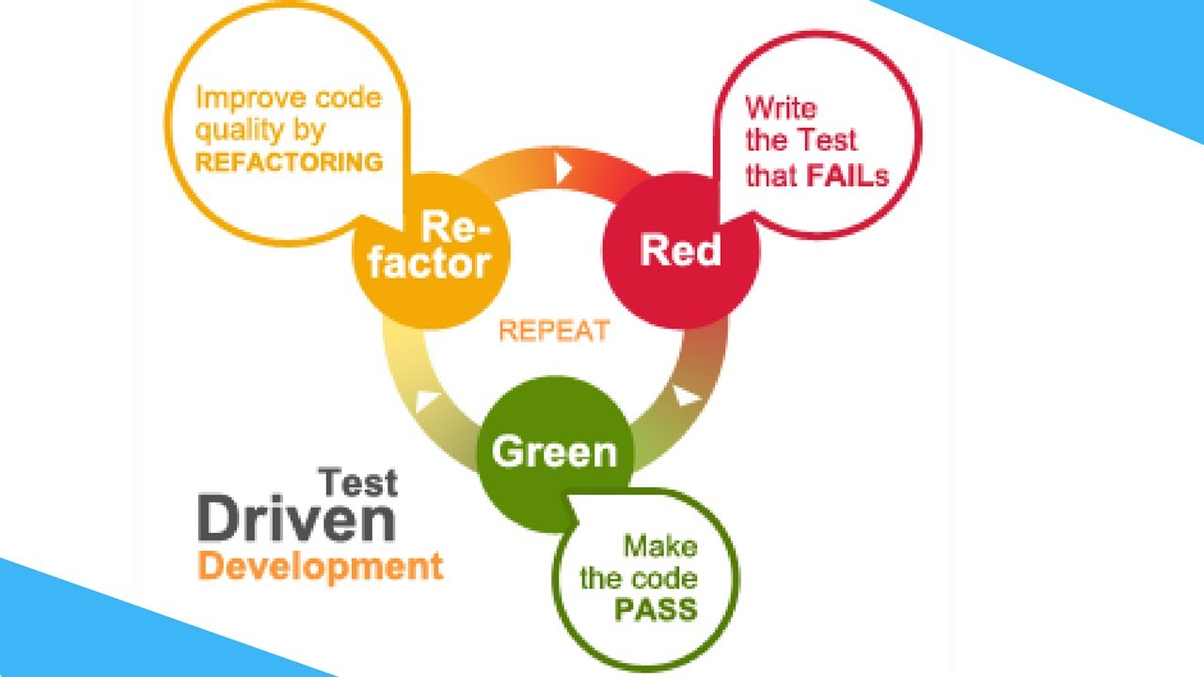
Applications of Junit (TDD)

Slide 5
Principles of testing frameworks
Each unit test should run independently of all other unit tests
Errors must be detected and reported test by test
It must be easy to define which unit tests will run
It should be easy to add unit tests
Help us reduce the cost of writing test by reusing code

Slide 6
Disadvantages
Cannot do dependency testing. by using Mockito we can achieve this
Not suitable for higher level of testing. (Large test suites)

Slide 7
Important Annotations
Annotation | Description
@Test | To mark a method as a test method
@Test(expected=ExceptionClassName.class) | To mark a method for the exception scenario
@Before | Will execute before each test method
@After | Will execute after each test method
@BeforeClass | Will run before entire test class
@AfterClass | Will run after entire test class
@Ignore | If we use this annontation on the method that method will be ignored

Slide 8
@RunWith(SpringJUnit4ClassRunner.class)
It extends BlockJUnit4ClassRunner.class
Implements JunitRunner framework for writing Integration Test
static org.junit.Assert.* - To use the static assert methods
Return type of every Assert method is void

Slide 9
Important Methods
Method | Description
void assertNull(Object obj) | Checks that the object is null
void assertNotNull(Object obj) | Checks that the object is not null
void assertEquals(boolean expected, boolean actual) | Checks that two primitives/objects are equal
void assertTrue(boolean condition) | Checks that the condition is true
void assertFalse(boolean condition) | Checks that the condition is false
void assertSame(obj1, obj2) | Checks that two object references are pointing to the same Object
void assertNotSame(obj1, obj2) | checks that two object references are not pointing to the same Object
void assertArrayEquals(expectedArray, actualArray) | Checks that the two arrays are equal

Slide 10
Parameterized Test
To use parameterized test we have to annotate the class name with @RunWith(Parameterized.class)
We can use parameterized test for testing a single method with different scenarios or inputs

Slide 11
Test Coverage / Code Coverage
TC or CC is the number of lines of our source code that is tested whenever unit tests are run against the source code.
We measure CC using tools.
Popular Tools:
1. EclEmma
2. Cobertura
3. JTest

Slide 12
Let’s see some examples

Slide 13
Mockito

Slide 14
Mocking
Testing in Isolation, Testing our code without testing our dependency(Dependencies are tested automatically)
A------------------->B
Mock
Example Scenario
If class A depends on or uses Class B and if we are unit testing class A then we will mockout Class B and all of its methods that class A uses

Slide 15
Steps in Mocking
Step 1. Stubbing
Step 2. Setting the Expectations
Step 3. Verifying
Step1 & Step2 or Stubbing & Setting the Expectations = @Mock (when, thenReturn and thenThrow, etc)
Verifying = verify, matchers, etc

Slide 16
Let’s see an example

